Slide 1
CS499 - Open Source software development
Lecture #02: Basics about open source software
Dr. Igor Steinmacher
e-mail: igorfs@utfpr.edu.br
Twitter: @igorsteinmacher

Slide 2
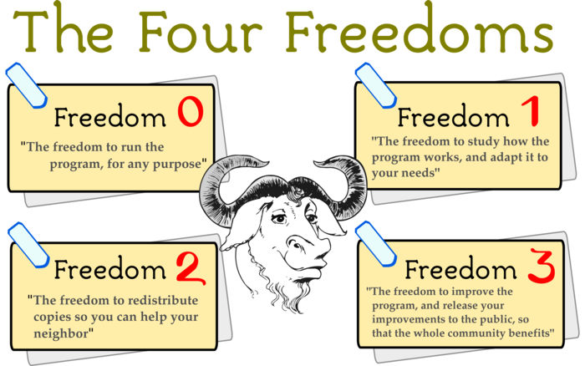

Slide 3

Questions
What is Open Source about?
Notes:
c

Slide 4
Questions
What is Open Source about?
Price?
Notes:
c

Slide 5
Questions
What is Open Source about?
Price?
License?
Notes:
c

Slide 6
Questions
What is Open Source about?
Price?
License?
Social Movement?
Notes:
c

Slide 7
Questions
What is Open Source about?
Price?
License?
Social Movement?
Hobby?
Notes:
c

Slide 8
Questions
What is Open Source about?
Price?
License?
Social Movement?
Hobby?
Market trend?
Notes:
c

Slide 9

So…
Open Source is about…
Freedom
License
Code as a way to share knowledge
Community!

Slide 10

A little bit of history

Slide 11
Pre-historic…
Commercial settings:
software is usually part of a bigger solution (consulting, hardware, maintenance, etc.)
not a solution per se
Academic settings:
Software is informally shared as a way to share knowledge
Hobbyists
Hacking for fun
Garage programmers community

Slide 12
And the History…
1976 – Bill Gates’ “Open Letter to Hobbyists”
Copyright infringement + commercial power
“Will quality software be written for the hobby market?”
“One thing you do do is prevent good software from being written.”
1980 – Stallman problem with Xerox printer
Stallman refused access to the source code for the printer driver
1981 – IBM signs a deal with “Micro-Soft”
MS-DOS embedded in each and every IBM machine
1984 – Stallman launches GNU project
1985 – Free Software Foundation (FSF) was formed to house funding for the GNU Project

Slide 13
And the History…
1991 – Linus Torvalds creates (or kicks off) Linux
Personal/informal project
Message to a newsgroup at Usenet
V 1.0.0 released in 1994 with 170+ KLoC
1995 – Internet Boom
Linux is distributed in large-scale
1997 – Eric Raymond writes “The Cathedral and the Bazaar”
Advantages of Open Source
Development in a decentralized way

Slide 14
And the History…
1998 – Netscape open-sourced
Fight with MS Explorer?
1998 – Eric Raymond, Linus Torvalds and others launch the Open Source Initiative (OSI)
Technical reasons to Open-source
Use of “Open Source” instead of “Free software”
1999 – Sourceforge is launched
2000 – OpenOffice is launched
2001 – IBM invests $1 billion on Linux

Slide 15
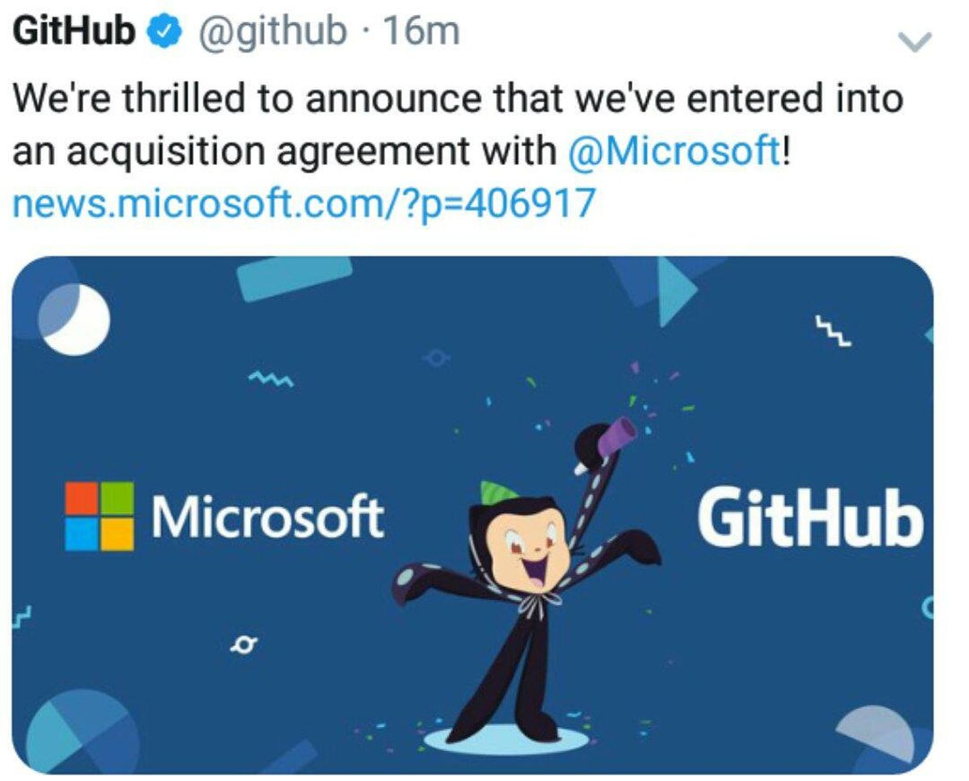
And the History…
2005 – Sun launches Solaris 10 as Open Source
2007 – Sun launches JDK under GPL
GitHub launches in 2008
GitHub BOOM ~2010–2011 (2 million repos in 2011)
… MANY COMPANIES JOINING

Slide 16
Why OSS???

Slide 17
Why Open Source?
Incentive to collaboration → human relationship
Technical education
“Low-cost” access to “high-end” technology
Decentralizes the “power” of the software
Government → knowledge and transparency

Slide 18
Why Open Source?
Less duplicated code (and cost)
Less bugs → More quality
“Given enough eye-balls all bugs are shallow”
Customization and improvements
Competition for support

Slide 19
Final facts

Slide 20
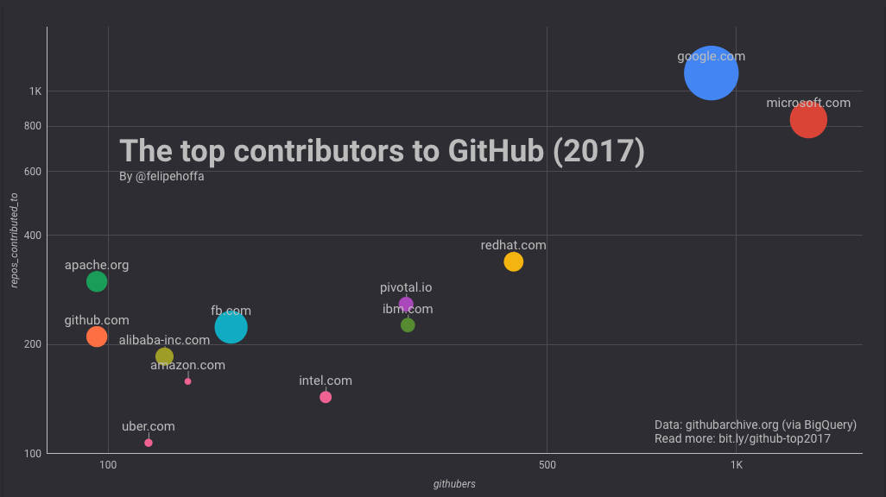
And… Open source leads the way

Slide 21

Why are companies Open-sourcing?

Slide 22

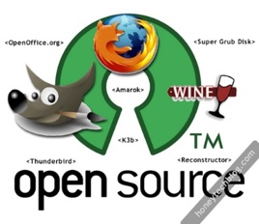

Leveraging the Crowd
“The World Wide Web became a tool for bringing together the small contributions of millions of people and making them matter”
Collaboration in large-scale

Slide 23
Pinto, Steinmacher, Dias and Gerosa, On the Challenges of Open-Sourcing Proprietary Software Projects, Empirical Software Engineering, 2018

Slide 24

All About Community!
OpenStack:
1.7M lines of code
19 programming languages
17K community members
5K+ code contributors
38K e-mail messages
Mozilla Firefox:
13.5M lines of code
37 programming languages
4K+ contributors (1K+ in the last 12 months)
4,231 years of effort (COCOMO model) - first commit in 2002
Swift:
445K lines of code
Over the past 12 months, 400+ developers
https://www.openhub.net/p/openstack
https://opensource.com/business/14/6/openstack-numbers
https://www.openhub.net/p/apple_swift

